Slide 1
The Transformation of "Judicial Consciousness" in Taiwan under Japanese Rule (1895-1945):
An Analysis on the Taiwan Colonial Court Records Archives
Tay-sheng Wang
NTU Chair Professor, College of Law
National Taiwan University

Slide 2
Introduction
It is not unusual in the history that a specific legal system relating to dispute resolution and crime conviction was transplanted into other countries, which were totally unknown to it at the beginning. Those people who encountered with new legal system in fact received it with their own pace and ways.
to present the story of Taiwan, who has experienced the transformation of judicial system from late 19th century to the present days.
the legal consciousness of judicial affairs, called “judicial consciousness,” of the general public in Taiwan
the Taiwan Colonial Court Records Archives, which include civil and criminal decisions of district courts established by prewar Japanese Empire in colonial Taiwan during the period from 1895 to 1945.
Notes:
There are different ways to deal with dispute resolution and crime conviction in different countries or law families on the basis of their social conditions and value. It is not unusual in the history that a specific legal system relating to dispute resolution and crime conviction has been transplanted into another countries which is totally unknown to it at the beginning. Those people who face this new judicial system

Slide 3
Traditional consciousness of justice in traditional China
The modernized Japanese law was introduced to Taiwan when Japan acquired the sovereignty of Taiwan in 1895. At this time, the super majority of people in Taiwan were ethically or culturally Chinese, who were familiar with Chinese legal traditions.
There did not exist the legal concept of “civil matters” or “criminal matters” in traditional Chinese law.
“household, marriage, farm, land and debt of money” ≠ civil matters

Slide 4
In Qing China, the magistrate of local government had power to “resolve” disputes concerning “household, marriage, farm, land and debt of money” and to punish the criminals with penalty of flogging, which was imposed on “petty” crimes, rather than “serious” crimes.
It was common place for magistrates of local government in Taiwan to resolve disputes or declare someone guilt without referring to official provisions.
Nevertheless, a promise not to argue again made by parties was required for any dispute resolution, and a confession made by convicts was required for any declaration of guilt in imperial China. In other words, the accused must “agree” the disposal of officials.

Slide 5
Modern court system and administrative mediation in colonial Taiwan
The new-coming Japanese immediately implemented the modern-style court system, which Meiji Japan received from France first and Germany later, in colonial Taiwan in 1896.
Adjudication was a decision made by the judge in accordance with the law; by contrast, mediation was a process in which a mediator encouraged disputing parties to reach a compromise. But, both did not exist in traditional Chinese law.

Slide 6
Since 1896, the Taiwanese in practice welcomed the modern-style adjudication.
Nevertheless, in order to operate this kind of adjudication, the colonial government had to establish and maintain courts, which needed much money to build the house of court and employ lots of judicial personnel.
the Japanese authorities created “administrative mediation for civil disputes” in colonial Taiwan so as to reduce the caseload of the court in 1904.
In fact, the Japanese authorities did restore traditional practice of dispute resolution with modern legal terminology.
called “mediation,” but in practice was handled and finally decided by the mediating official in the name of “compromise” and did not abide by the law because it was not “adjudication” in form.

Slide 7
As a consequence, when Taiwanese could not resolve their disputes through real mediation in the society and wanted to get help from the state authority, the Japanese state offered two kinds: modern adjudication in the court, and traditional “mediation” in the local government.
After 1915, Taiwanese had showed their preferring to adjudication.
However, the administrative mediation had already obstructed the spread of modern-style adjudication, that is, rule of law, in Taiwanese society.

Slide 8
The lawyer in accusatory method of civil trial
In traditional China, based on the parent-official ideology, a person who helped disputing parties with legal expertise was considered unnecessary. If such a person appeared in any disputes filed in the local government, the magistrates would regard him as a “trouble maker,” although the general public considered him “a master in litigation.”
Based on individualism in modern Europe, people were able to make the best arguments for themselves in the civil trial, with the assistance of legal experts, namely, lawyers. Meanwhile, the judge was forbidden to take into consideration any facts or legal arguments that were not advocated by parties in the trial.

Slide 9
it was relatively prevalent to hire a master in litigation while filing their disputes in local government in Qing Taiwan.
Japanese lawyers were also welcomed by Taiwanese disputing parties. Nevertheless, the Taiwanese were initially unknown to the role of lawyers in the law-finding process of the court because the traditional litigation paid little attention to argue what official provisions should be applied.
Since the 1920s, some of the young generation of Taiwanese who had received modern education became lawyers, and general public had gradually understood the role of lawyers in the modern court.

Slide 10
Focusing on facts-finding in the inquisitorial proceedings of imperial China, magistrates required disputing parties themselves to be appeared in front of him. Only when disputing parties were the old, the child, the female, and the gentry, their male relatives or the employees of gentry class could answer the interrogation of magistrates on behalf of them.
Emphasizing in law-finding, the modern court encouraged disputing parties to allow a legal expert on behalf of them in the civil lawsuits.
In colonial Taiwan, the agent of civil litigation was thus not required to be legal profession in the early period of Japanese rule so that relatives or employees were eligible for the agents of civil litigation.
Since 1923, the provision allowing relatives or employees to be agents of civil litigation became invalid.

Slide 11
The prosecutor in accusatory method of criminal trial
After the French Revolution, the role of prosecutor was been justified for separating the judicial power. The modern prosecutor was regarded as the plaintiff on behalf of the state in the accusatory procedure on the basis of the model of state vs. individual.
There was no ideology like the separation of state power or liberal individualism in imperial China, and therefore the role of prosecutor was never found in criminal justice of imperial China.

Slide 12
Although the modern court system in which the prosecutor existed had been implemented in colonial Taiwan since 1896, the Japanese authorities reinforced the summary judgment system in Taiwan in 1904.
This system was also duplication of traditional crime conviction with modern legal terminology.
The 1904 Summary Judgment Law allowed the head of the local government to summarily decide police offences as well as certain minor crimes in colonial Taiwan. But police officials were empowered to make summary judgments on behalf of the head of local government.
the majority of accused were convicted by police officials, not prosecuted by prosecutors. As a result, Taiwanese people had few opportunities to contact prosecutors and further understand the accusatory proceedings in the modern court.

Slide 13
Analysis based on the Taiwan Colonial Court Records Archives
I want to explore how the characteristic of individual case, including the types or years of the disputes as well as the residence, sex, or other nature of parties, had already influenced various kinds of activities in the court, and shaped the judicial consciousness of the Taiwanese in colonial days.
The units of analysis are 48,338 cases in the civil decisions of the Taipei district court as well as 82,407 cases in the criminal decisions of the same court. We collected the data relating to parties, agents of litigation, cause of action, date of decision, judge, prosecutor, appeal or not and so on.

Slide 14
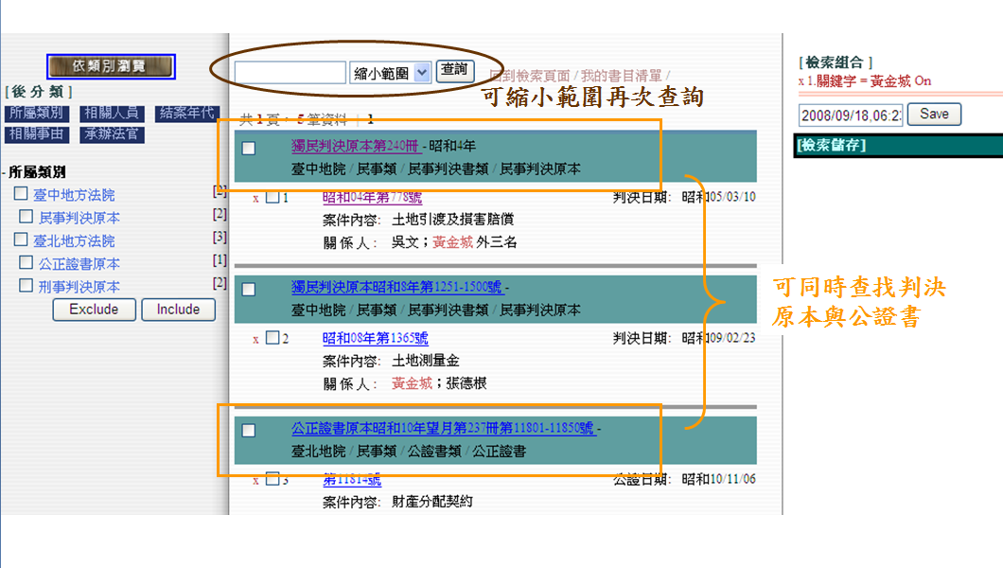
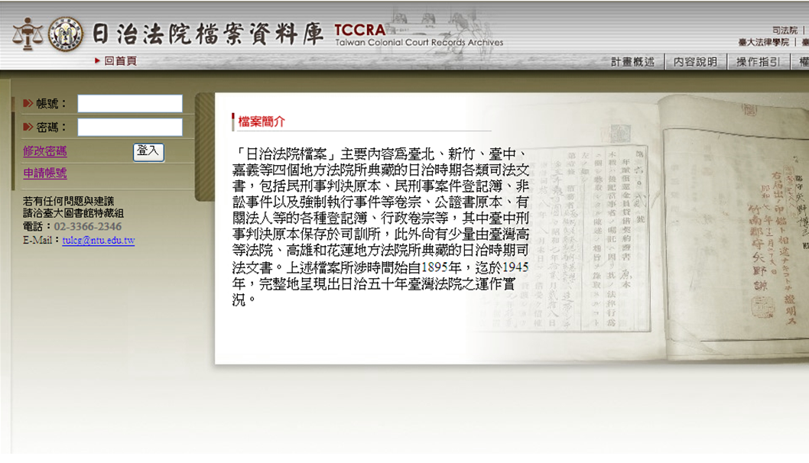
TCCRA in National Taiwan University Library: Open to Researchers of the World
It is easy to search what you need.

Slide 15
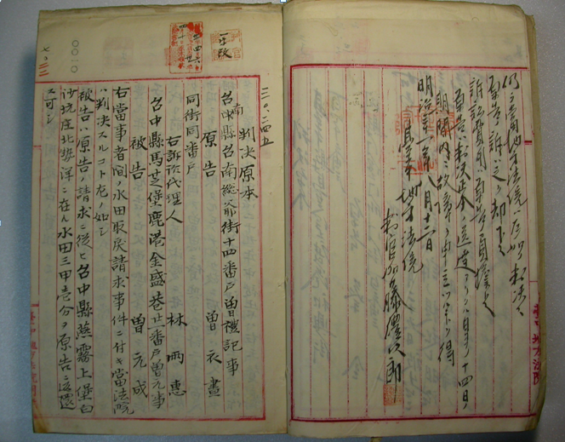
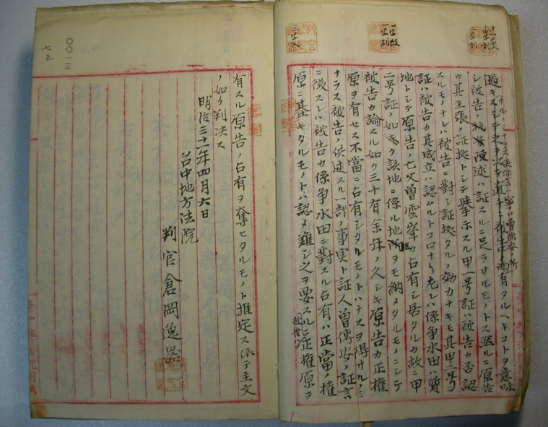
An Example of Civil Decisions in TCCRA
The District Court

Slide 16
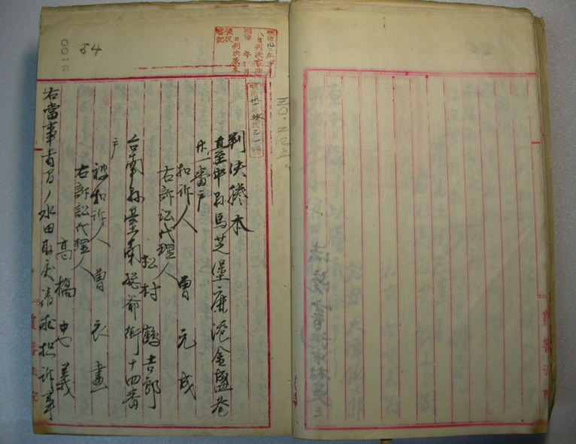
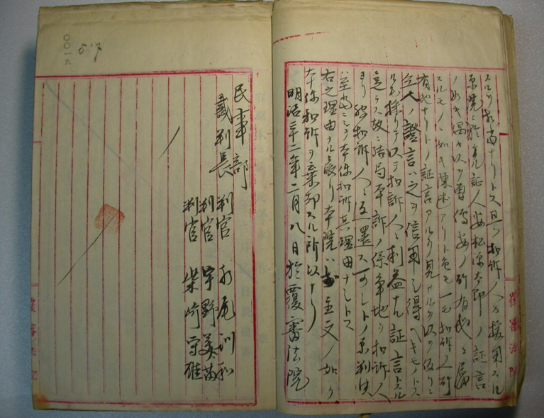
An Example of Civil Decisions in TCCRA
The Court of Appeal

Slide 17
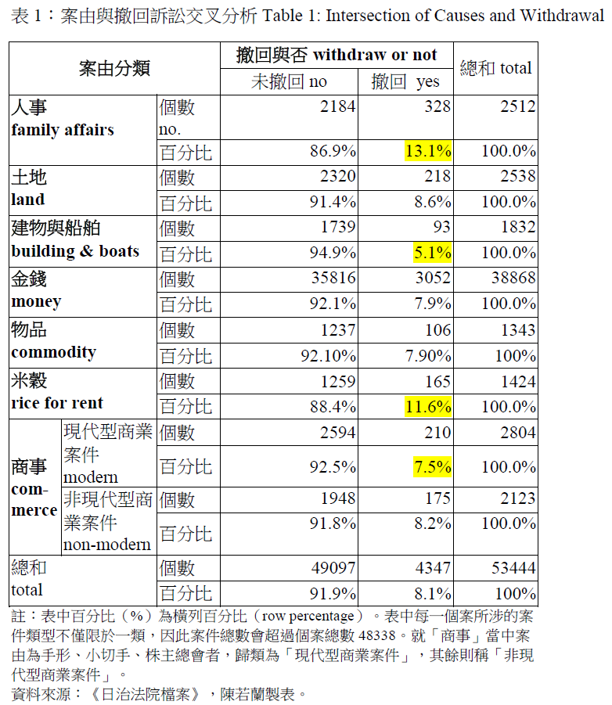
Survey on the Access to Adjudication in Courts/Rule of Law

Slide 18
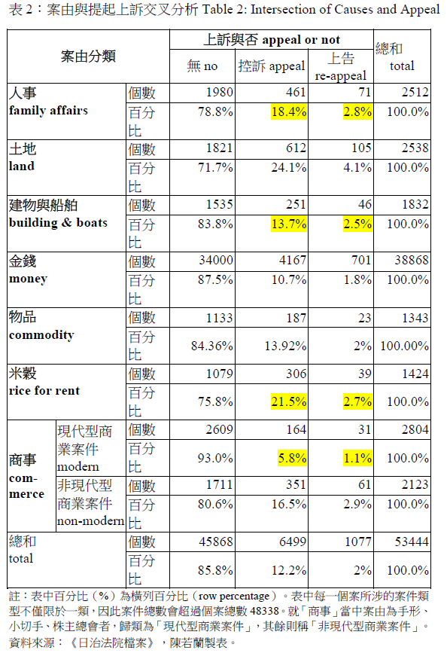

Slide 19
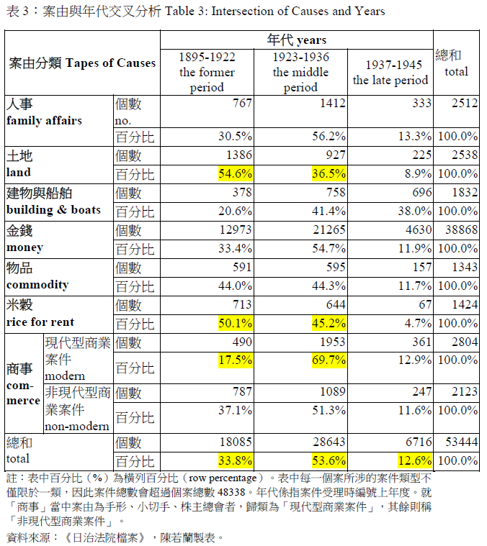

Slide 20
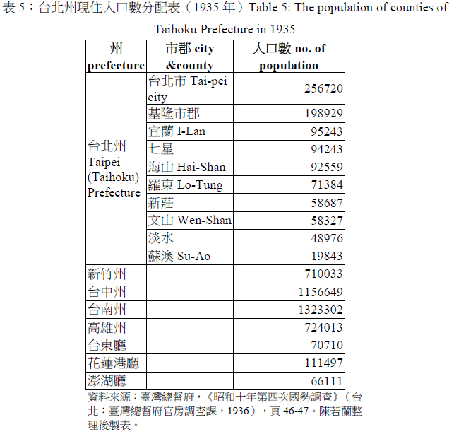

Slide 21
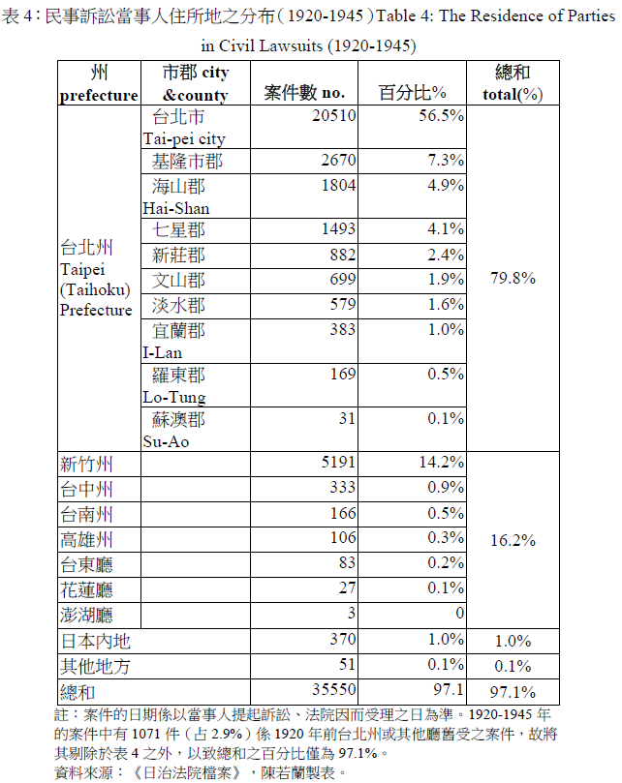

Slide 22
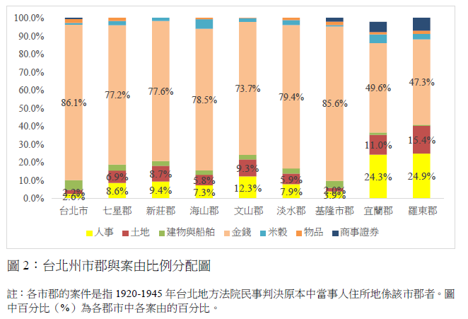

Slide 23
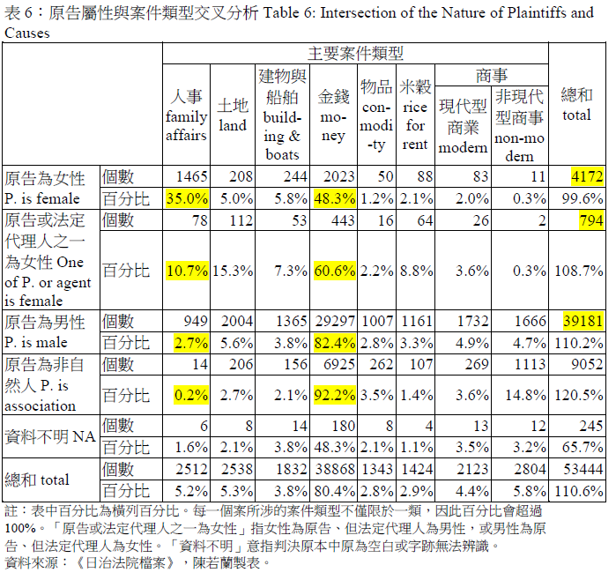

Slide 24
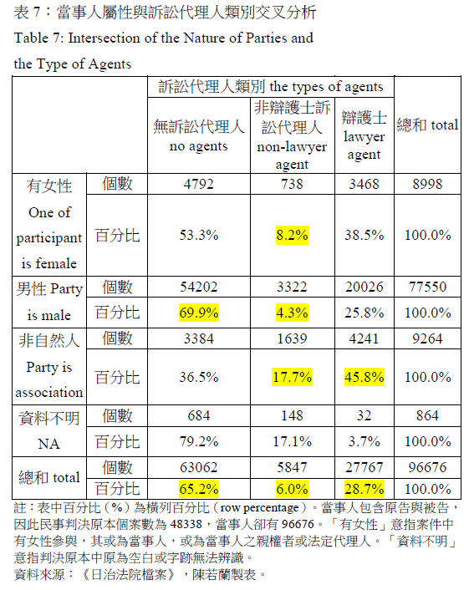
Survey on the Access to Lawyers

Slide 25
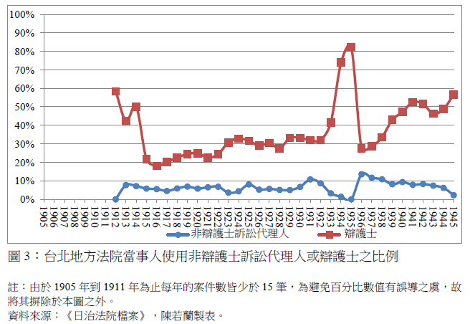

Slide 26
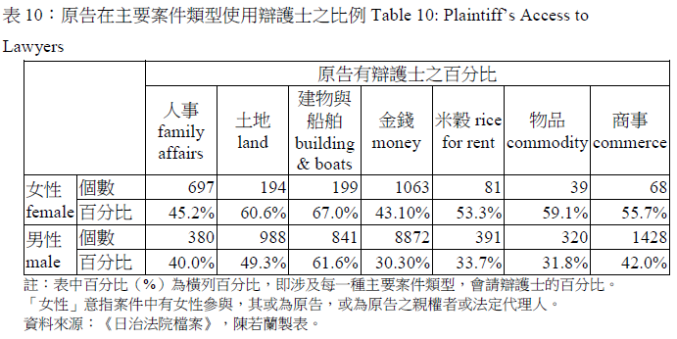

Slide 27
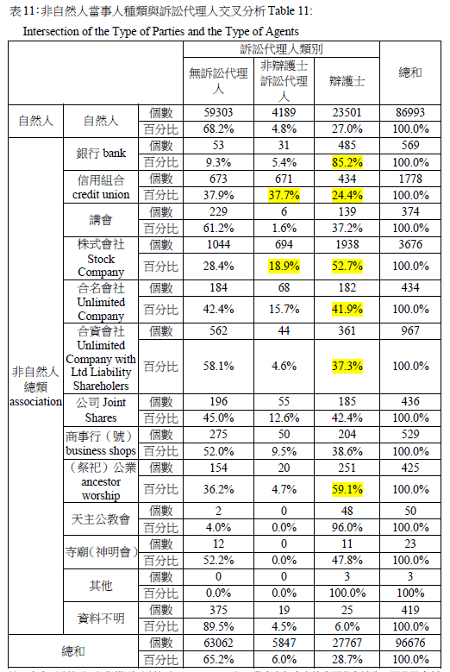

Slide 28
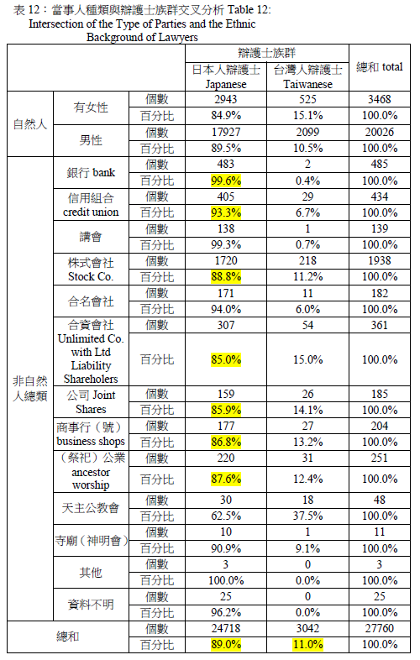

Slide 29
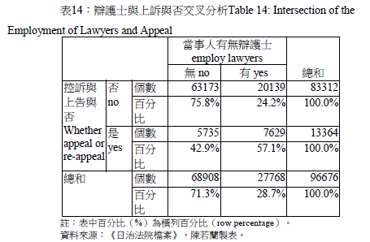

Slide 30
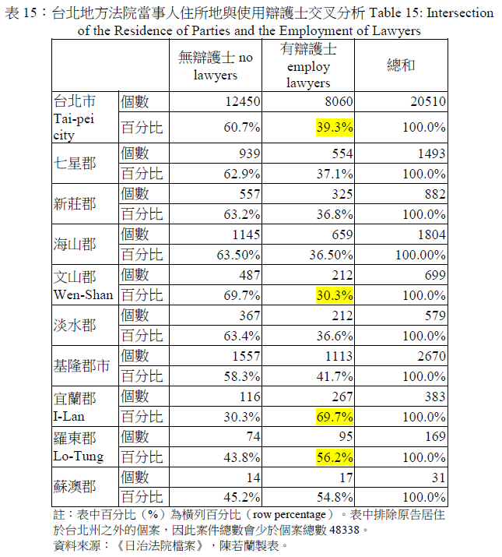

Slide 31
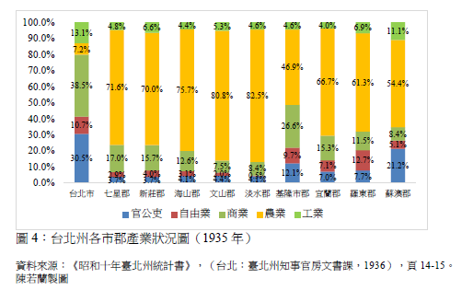

Slide 32
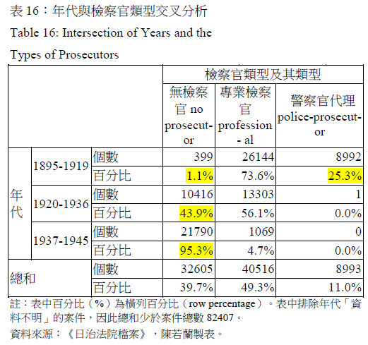
Survey on the Access to Prosecutors

Slide 33
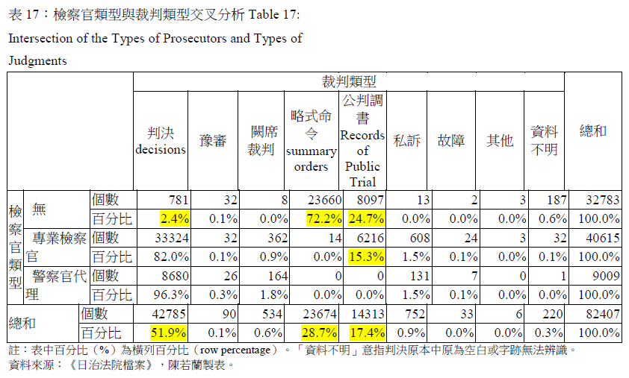

Slide 34
Conclusion
Japanese authorities introduced modern judicial systems to colonial Taiwan merely because Japan, as the mother country, had adopted them. Promoting the modern judiciary was never the priority of the colonial government. However, the Taiwanese had to a certain extent received modern-style “judicial consciousness” through the actual administration of courts during the period of fifty-year Japanese rule.

